Slide 1
English for meddies
ASAP science

Slide 2
Today you will see…
Heated debates upon the medical topic
Advertisement
Study at KSMU
Breaking news – report about CBL
Social life of KSMU students

Slide 3
HEATED DEBATES
WE WILL UNDERSTAND
WHAT THE DEBATES MEAN;
TRY ONE’S HAND IN IT;
MAKE A CONCLUSION

Slide 4
ADVERTISEMENT
WE WILL UNDERSTAND HOW THE MEDICAL IINOVATIONS ARE BEING USED NOWADAYS;
WE WILL CHILLAX A LITTLE

Slide 5
Our thorough report from KSMU: how do the students study there?

Slide 6
Working hard-doing our best
Preparation for the final exam
vocabulary: Kazakhstan and the UK
Grammar: articles
Answering the questions:
what do you know about kazakhstan?
About the united kingdom of great Britain and northern Ireland?

Slide 7
Try to refresh the knowledge in your mind:
Give the characteristic features of Kazakhstan
Name it’s total area
What countries does Kazakhstan border with?
Describe the landscape of your motherland
Name its form of government
Describe the highest representative body of the state
Speak about the capital of Kazakhstan

Slide 8
Answering the questions –listening to music

Slide 10
Breaking news
CBL STUDYING TECHNOLOGY IN KSMU
SEE OUR BRIEF REPORT

Slide 11
Social life in KSMU
Being singers
Being translators
Creating new
Remember past looking for the future

Slide 12
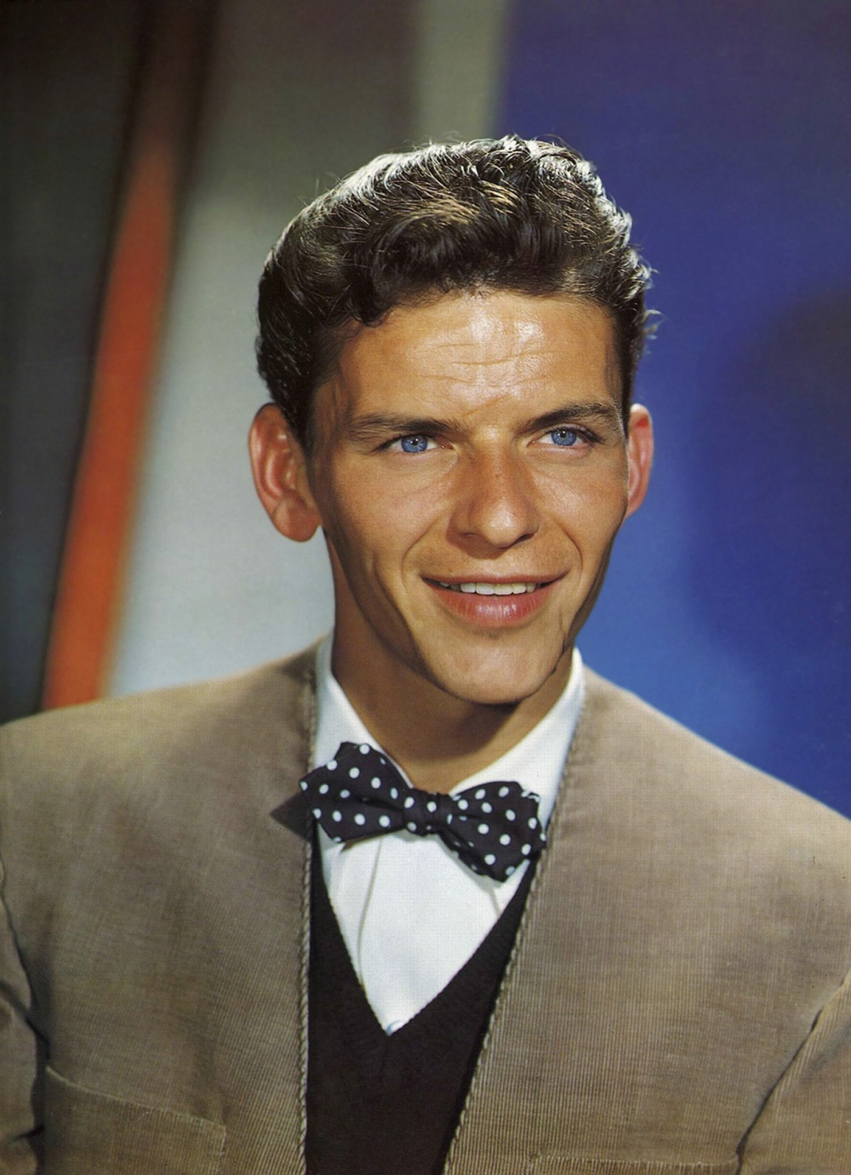
WHO IS FRANK SINATRA?
Legendary singer Frank (Francis Albert) Sinatra was arguably one of the greatest—and most acclaimed— vocalists in this century; he made 1,414 studio recordings and had at least one song on the music charts every year between 1945 and 1995. He was as much noted for his passionate approach to life as for his music, and his ironclad self-confidence combined with classic good looks, pitched him into the realm of celebrity early in his career. He married high-profile actresses and starred in films himself, and his glamorous lifestyle eventually epitomized the Hollywood of the 1950s and 1960s.

Slide 13
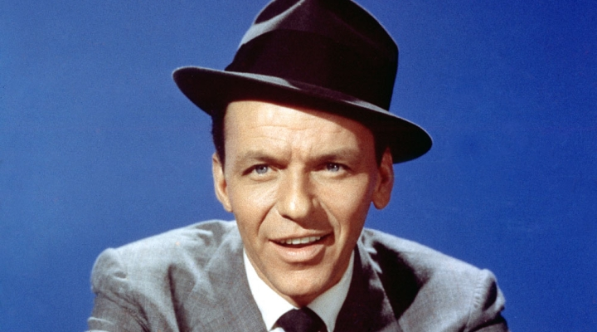
Frank Sinatra became an icon due to his romantic ballads, smooth, heartfelt vocal style, timeless material, and abundance of style. His singles “My Way” and “New York, New York” were so popular they transcended music to become a part of a larger, cultural bond, Time magazine’s Jay Cocks wrote, “Not only does his music define the time and temper of the American decades in which it was made, but his singing moves those songs out of time into something indistinct, everlasting. In Sinatra’s music, there is no past tense. You could say he was the greatest, and that’s right. But… there’s nothing you can call him that doesn’t in some way sell him short. Except Sinatra.”

Slide 14
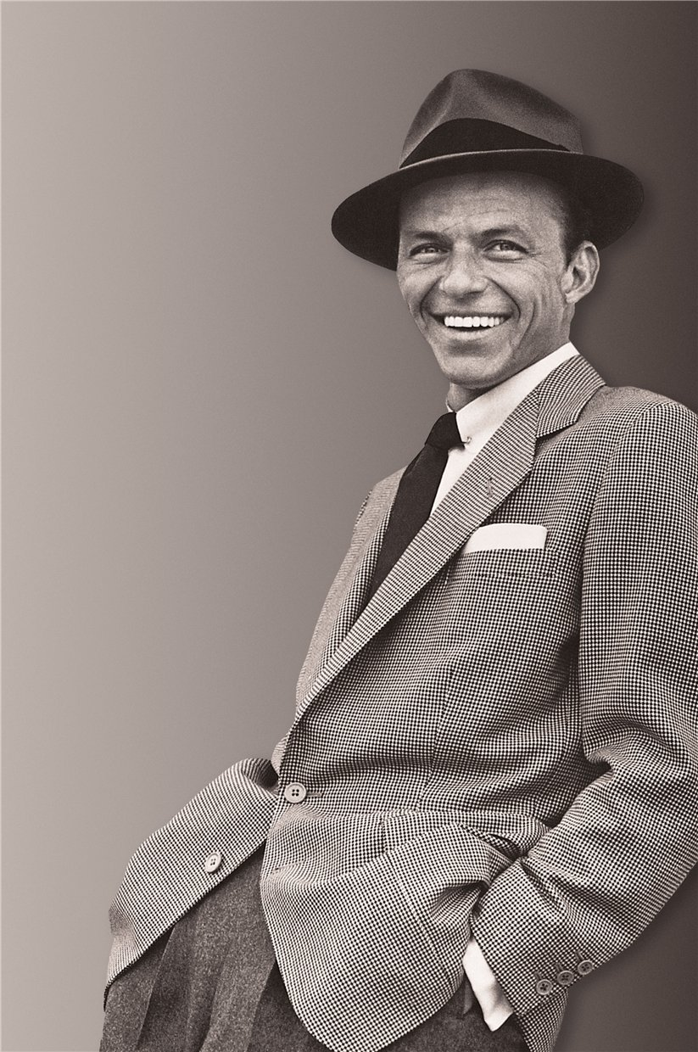
I WON’T DANCE
SHORT VIDEO
INFORMATION
LET’S SING

Slide 19
Having spent a great and bright day at KSMU, we can say that our medicine is in good hands
Thank you for watching
Joins us tomorrow

Slide 20
YOURS ENGLISH FOR MEDDIES

